Slide 1
Search
Chen-Yu Wei

Slide 2
Announcement
Homework 1 – Choices Problem Q1, Q5, Q8 have been updated

Slide 3
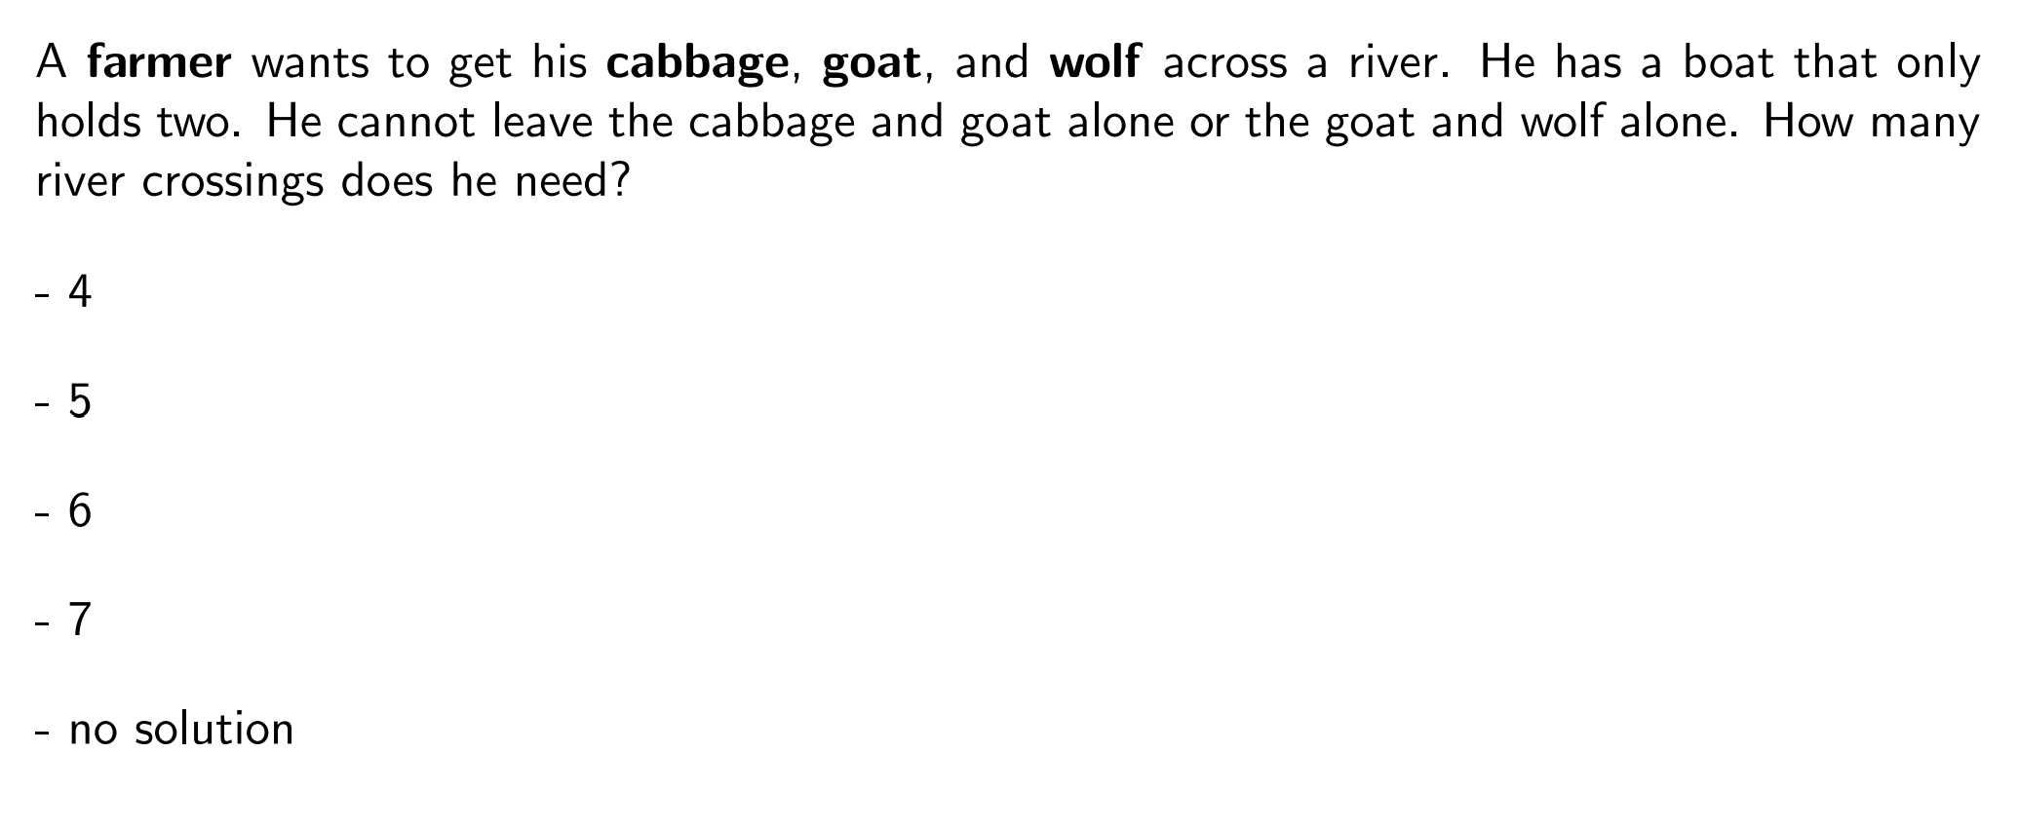
Question
https://stanford-cs221.github.io/autumn2023-extra/modules/search/modeling.pdf

Slide 4
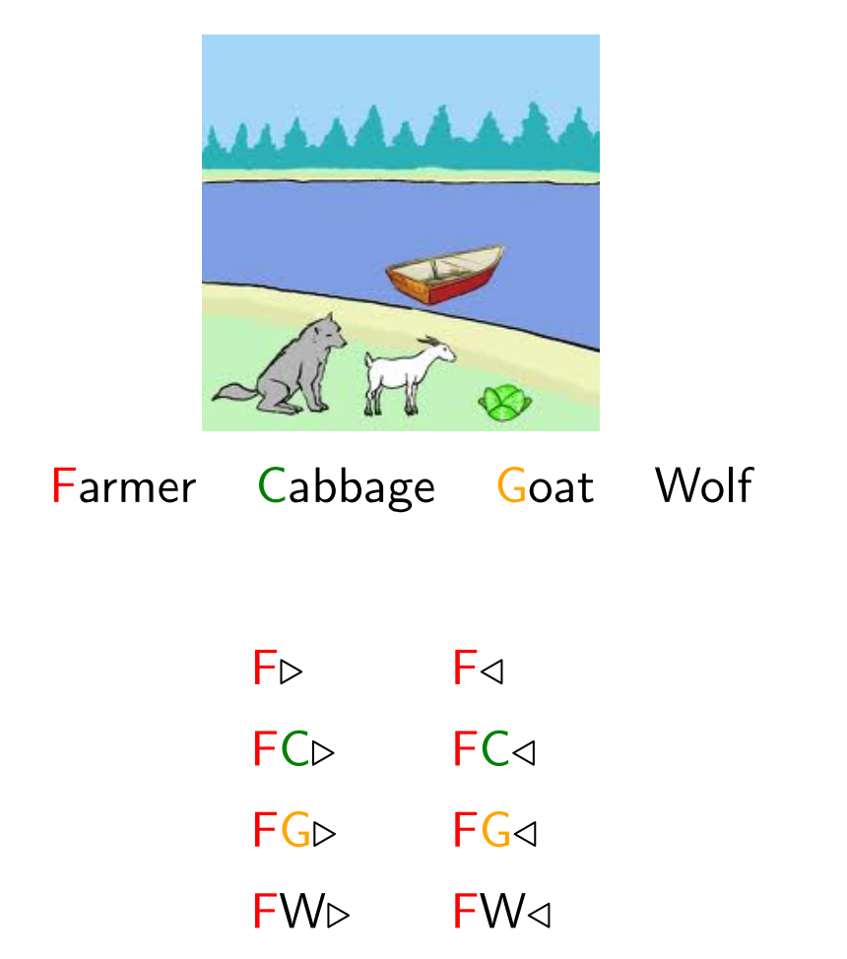
Model the Problem
How many different “states”?
How many different “actions”?

Slide 5
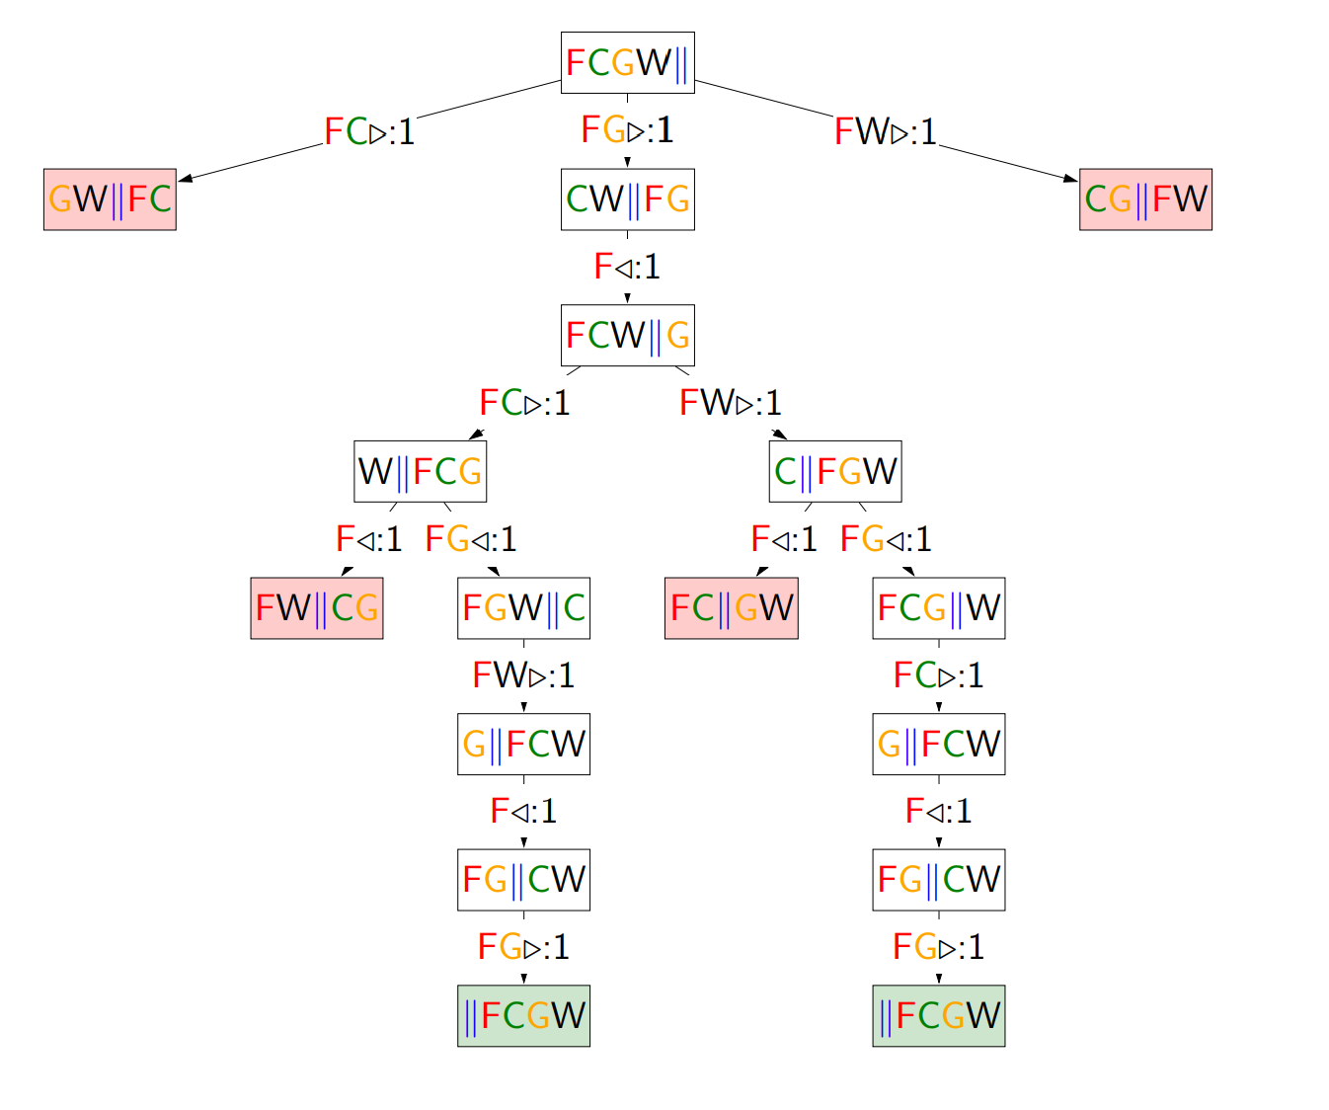
Build a Search Tree

Slide 6
Search Problem
State space
Initial state
Goal test: Given a state, return whether the state is a goal
Action
Successor function: Given current state and action, return the new state
(The cost of an action)

Slide 7
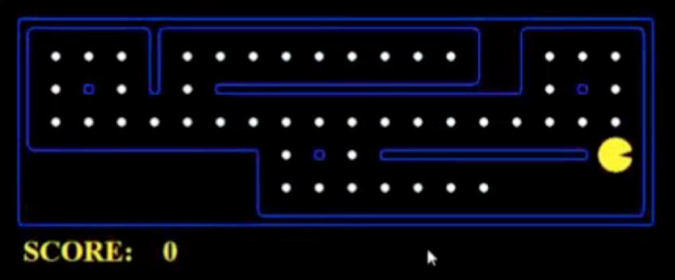
Example: PACMAN
Eat all dots
States: {(x,y), dot booleans}
Actions: NSEW
Successor: update location and possibly a dot boolean
Goal test: dots all false
Go to some destination
States: (x,y) location
Actions: NSEW
Successor: update location only
Goal test: is (x,y)=END

Slide 8
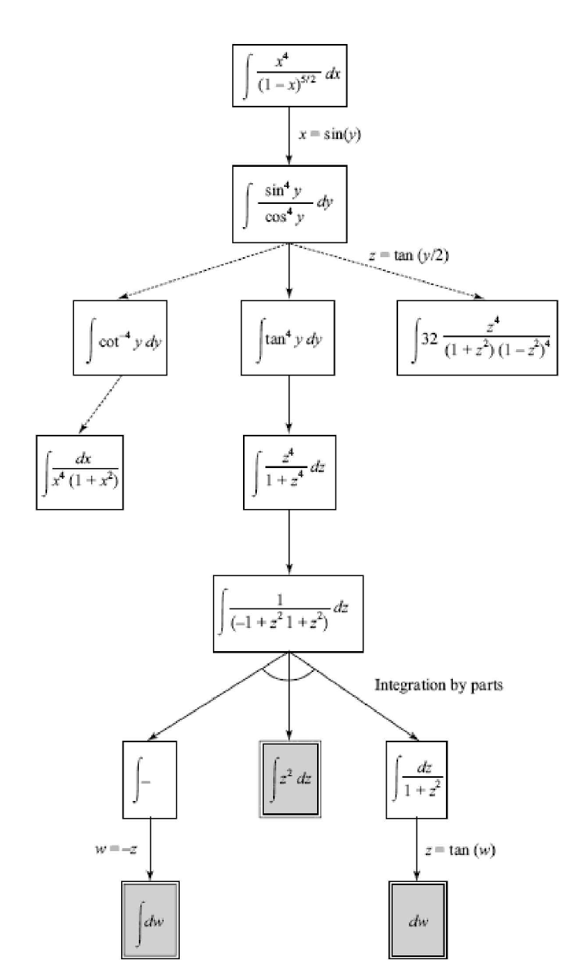
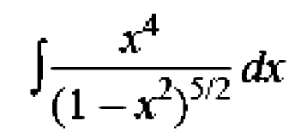
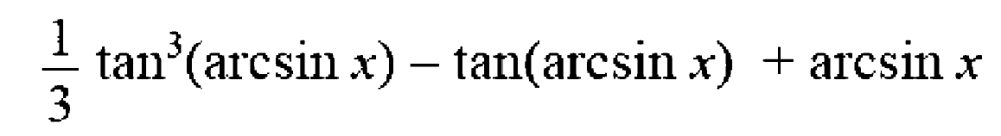
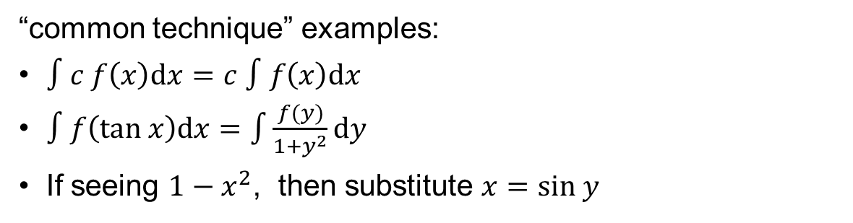
Example: SAINT (Slagle, 1961)
Symbolic Integrator
States: symbolic expression
Actions: “common techniques”
Successor: the new expression after applying the technique
Goal test: whether the expression is in “standard form”
“common technique” examples:
$∫c f\left(x\right)dx=c ∫f\left(x\right)dx$
$∫f\left(tan x\right)dx=\int{\frac{f(y)}{1+y^{2}}}dy$
If seeing $1−x^{2}$, then substitute $x=sin y$

Slide 9
Example: Machine translation
Translate “你好嗎” to English
States: current word sequence
Actions: the next word
Successor: the concatenation of current sequence and next word
Goal test: whether the current sequence means the same as 你好嗎
Why is you
Why is
Why is I
Why
Why are
Why are you
Why are I
What is
What
What are
How
How is
……
How are

Slide 10
Topics
BFS
DFS
UCS (Dijkstra Algorithm)
Difference with DSA2:
The state space is exponentially large, and it’s unlikely we’ll store the whole state space in memory

Slide 11
General Framework

Slide 12
State Space and Search Tree
State Space Graph
Each NODE in in the search tree is an entire PATH in the state space graph.
Search Tree
S
a
G
d
e
p
b
c
b
c
e
h
r
q
d
e
f
a
a
h
r
p
q
f
S
h
We construct both on demand – and we construct as little as possible.
p
r
p
q
f
q
c
G
q
a
q
c
G
a

Slide 13







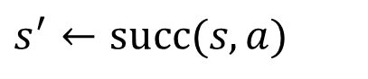
A General Framework
Expanded $←$ { }
Frontier $←$ { initial_state }
While Frontier is not empty:
Choose a node $s$ from Frontier
①
For all action $a$:
$$s^{′}←succ(s,a)$$
②
If $s′$ has not been reached
Put $s′$ in Frontier
Move $s$ to Expanded
③
All nodes that are not in Expanded or Frontier
Nodes are divided into 3 groups: Expanded, Frontier, and Unreached.

Slide 14
⓪ Place the initial state in Frontier

Slide 15

① Choose a node $s$ from Frontier

Slide 16
② Move all unreached successors of $s$ to Frontier

Slide 17

③ Move $s$ to Expanded

Slide 18
① Choose a node $s$ from Frontier

Slide 19
② Move all unreached successors of $s$ to Frontier

Slide 20
③ Move $s$ to Expanded

Slide 21
① Choose a node $s$ from Frontier

Slide 22
② Move all unreached successors of $s$ to Frontier

Slide 23
③ Move $s$ to Expanded

Slide 24
① Choose a node $s$ from Frontier

Slide 25
② Move all unreached successors of $s$ to Frontier

Slide 26
③ Move $s$ to Expanded

Slide 27






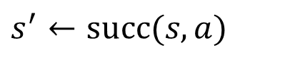



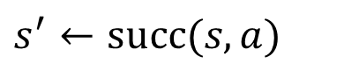




Implementation
Choose and then remove it
Expanded $←$ { }
Frontier $←$ { initial_state }
Frontier $←$ { initial_state }
While Frontier is not empty:
While Frontier is not empty:
Choose a node $s$ from Frontier
Pop a node $s$ from Frontier
For all action $a$:
For all action $a$:
$$s^{′}←succ(s,a)$$
$$s^{′}←succ(s,a)$$
If $s′$ has not been reached:
If not Reached[$s′$]:
Put $s′$ in Frontier
Put $s′$ in Frontier
Reached[$s′$] $←$ True
Move $s$ to Expanded

Slide 28
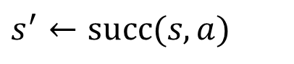











Termination When Goal is Encountered
Frontier $←$ { initial_state }
Frontier $←$ { initial_state }
While Frontier is not empty:
While Frontier is not empty:
Pop a node $s$ from Frontier
Pop a node $s$ from Frontier
If $s$ is a goal state, terminate
For all action $a$:
For all action $a$:
$$s^{′}←succ(s,a)$$
$$s^{′}←succ(s,a)$$
If not Reached[$s′$]:
If not Reached[$s′$]:
If $s′$ is a goal state, terminate
Put $s′$ in Frontier
Push $s′$ to Frontier
Reached[$s′$] $←$ True
Reached[$s′$] $←$ True
Late Goal Test
Early Goal Test

Slide 29
Termination When Goal is Encountered
Early Goal Test allows quicker termination when a goal is found.
Breadth First Search
Depth First Search
However, when actions are associated with costs and we want to find a minimum cost solution (i.e., cost-sensitive), we may have to use the Late Goal Test.
Uniform Cost Search (Dijkstra Algorithm)

Slide 30
Uninformed Search

Slide 31
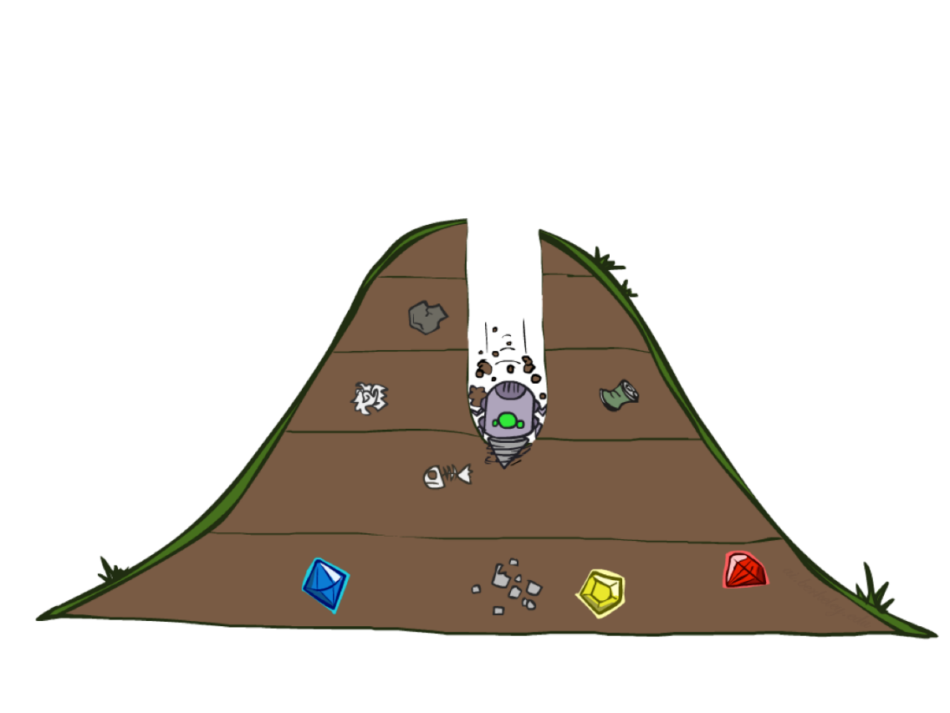
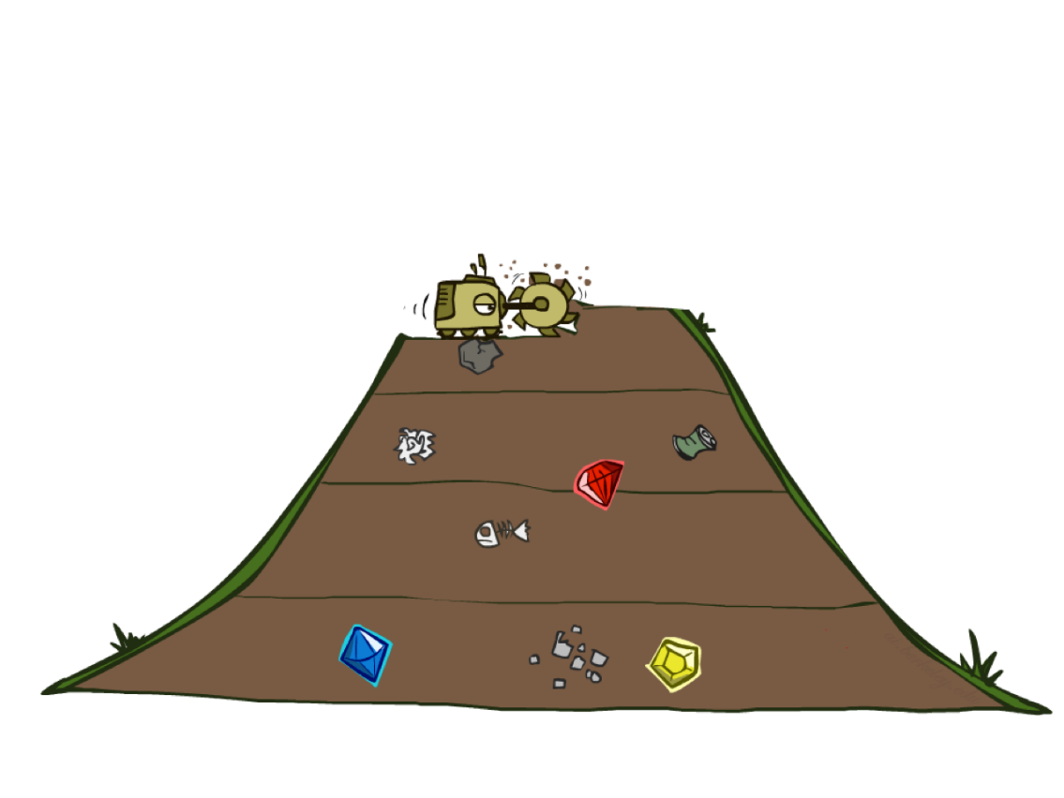
DFS and BFS
Depth First Search
Breadth First Search

Slide 32
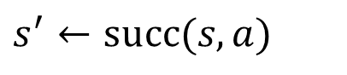







DFS and BFS
Frontier $←$ { initial_state }
While Frontier is not empty:
Pop a node $s$ from Frontier
differ here
For all action $a$:
$$s^{′}←succ(s,a)$$
If not Reached[$s′$]:
If $s′$ is a goal state, terminate
Push $s′$ to Frontier
Reached[$s′$] $←$ True

Slide 33

DFS
Frontier $←$ { initial_state }
While Frontier is not empty:
Pop the newest node $s$ from Frontier
For all action $a$:
$$s^{′}←succ(s,a)$$
If not Reached[$s′$]:
If $s′$ is a goal state, terminate
Push $s′$ to Frontier
Reached[$s′$] $←$ True

Slide 34
DFS
a
G
b
c
d
e
f
S
h
p
q
r
S
d
e
p
b
c
e
h
r
q
a
a
h
r
p
q
f
p
q
f
q
c
G
q
c
G
a
a

Slide 35
DFS
a
G
b
c
d
e
f
S
h
p
q
r
S
d
e
p
b
c
e
h
r
q
a
a
h
r
p
q
f
p
q
f
q
c
G
q
c
G
a
a

Slide 36
DFS
a
G
b
c
d
e
f
S
h
p
q
r
S
d
e
p
b
c
e
h
r
q
a
a
h
r
p
q
f
p
q
f
q
c
G
q
c
G
a
a

Slide 37
DFS
a
G
b
c
d
e
f
S
h
p
q
r
S
d
e
p
b
c
e
h
r
q
a
a
h
r
p
q
f
p
q
f
q
c
G
q
c
G
a
a

Slide 38
DFS
a
G
b
c
d
e
f
S
h
p
q
r
S
d
e
p
b
c
e
h
r
q
a
a
h
r
p
q
f
p
q
f
q
c
G
q
c
G
a
a

Slide 39
DFS
a
G
b
c
d
e
f
S
h
p
q
r
S
d
e
p
b
c
e
h
r
q
a
a
h
r
p
q
f
p
q
f
q
c
G
q
c
G
a
a

Slide 40
DFS
a
G
b
c
d
e
f
S
h
p
q
r
S
d
e
p
b
c
e
h
r
q
a
a
h
r
p
q
f
p
q
f
q
c
G
q
c
G
a
a

Slide 41
DFS
a
G
b
c
d
e
f
S
h
p
q
r
S
d
e
p
b
c
e
h
r
q
a
a
h
r
p
q
f
p
q
f
q
c
G
q
c
G
a
a

Slide 42
DFS
a
G
b
c
d
e
f
S
h
p
q
r
S
d
e
p
b
c
e
h
r
q
a
a
h
r
p
q
f
p
q
f
q
c
G
q
c
G
a
a

Slide 43
DFS
a
G
b
c
d
e
f
S
h
p
q
r
S
d
e
p
b
c
e
h
r
q
a
a
h
r
p
q
f
p
q
f
q
c
G
q
c
G
a
a

Slide 44
DFS
a
G
b
c
d
e
f
S
h
p
q
r
S
d
e
p
b
c
e
h
r
q
a
a
h
r
p
q
f
p
q
f
q
c
G
q
c
G
a
a

Slide 45
DFS
a
G
b
c
d
e
f
S
h
p
q
r
S
d
e
p
b
c
e
h
r
q
a
a
h
r
p
q
f
p
q
f
q
c
G
q
c
G
a
a

Slide 46

BFS
Frontier $←$ { initial_state }
While Frontier is not empty:
Pop the oldest node $s$ from Frontier
For all action $a$:
$$s^{′}←succ(s,a)$$
If not Reached[$s′$]:
If $s′$ is a goal state, terminate
Push $s′$ to Frontier
Reached[$s′$] $←$ True

Slide 47
BFS
a
G
b
c
d
e
f
S
h
p
q
r
S
d
e
p
b
c
e
h
r
q
a
a
h
r
p
q
f
p
q
f
q
c
G
q
c
G
a
a

Slide 48
BFS
a
G
b
c
d
e
f
S
h
p
q
r
S
d
e
p
b
c
e
h
r
q
a
a
h
r
p
q
f
p
q
f
q
c
G
q
c
G
a
a

Slide 49
BFS
a
G
b
c
d
e
f
S
h
p
q
r
S
d
e
p
b
c
e
h
r
q
a
a
h
r
p
q
f
p
q
f
q
c
G
q
c
G
a
a

Slide 50
BFS
a
G
b
c
d
e
f
S
h
p
q
r
S
d
e
p
b
c
e
h
r
q
a
a
h
r
p
q
f
p
q
f
q
c
G
q
c
G
a
a

Slide 51
BFS
a
G
b
c
d
e
f
S
h
p
q
r
S
d
e
p
b
c
e
h
r
q
a
a
h
r
p
q
f
p
q
f
q
c
G
q
c
G
a
a

Slide 52
BFS
a
G
b
c
d
e
f
S
h
p
q
r
S
d
e
p
b
c
e
h
r
q
a
a
h
r
p
q
f
p
q
f
q
c
G
q
c
G
a
a

Slide 53
BFS
a
G
b
c
d
e
f
S
h
p
q
r
S
d
e
p
b
c
e
h
r
q
a
a
h
r
p
q
f
p
q
f
q
c
G
q
c
G
a
a

Slide 54
BFS
a
G
b
c
d
e
f
S
h
p
q
r
S
d
e
p
b
c
e
h
r
q
a
a
h
r
p
q
f
p
q
f
q
c
G
q
c
G
a
a

Slide 55
BFS
a
G
b
c
d
e
f
S
h
p
q
r
S
d
e
p
b
c
e
h
r
q
a
a
h
r
p
q
f
p
q
f
q
c
G
q
c
G
a
a

Slide 56
BFS
a
G
b
c
d
e
f
S
h
p
q
r
S
d
e
p
b
c
e
h
r
q
a
a
h
r
p
q
f
p
q
f
q
c
G
q
c
G
a
a

Slide 57
BFS
a
G
b
c
d
e
f
S
h
p
q
r
S
d
e
p
b
c
e
h
r
q
a
a
h
r
p
q
f
p
q
f
q
c
G
q
c
G
a
a

Slide 58
BFS
a
G
b
c
d
e
f
S
h
p
q
r
S
d
e
p
b
c
e
h
r
q
a
a
h
r
p
q
f
p
q
f
q
c
G
q
c
G
a
a

Slide 59
BFS
a
G
b
c
d
e
f
S
h
p
q
r
S
d
e
p
b
c
e
h
r
q
a
a
h
r
p
q
f
p
q
f
q
c
G
q
c
G
a
a

Slide 60
DFS vs. BFS
In what cases is DFS quicker to find the goal?
In what cases is BFS quicker to find the goal?

Slide 61
DFS vs. BFS
Does DFS / BFS find the goal with the smallest depth?
…

Slide 62
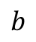
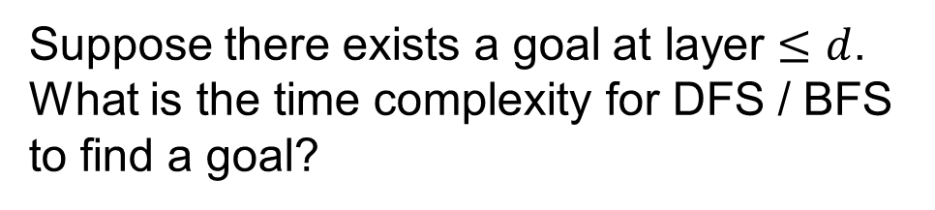
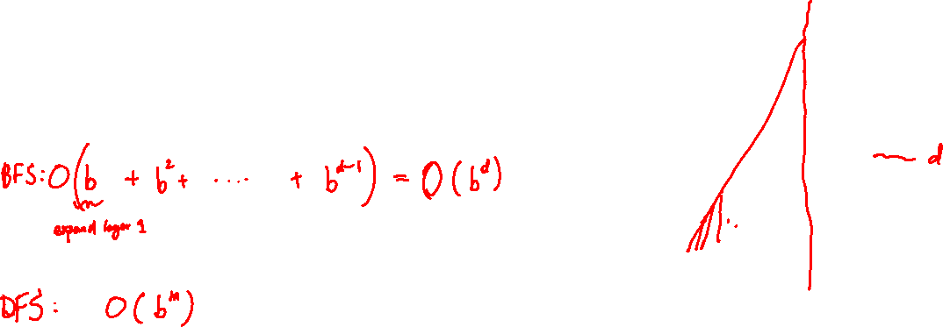

DFS vs. BFS
Suppose there exists a goal at layer $≤d$. What is the time complexity for DFS / BFS to find a goal?
$$b$$
…
$m$ layers
b: branching factor
m: maximum depth
Goals at various depths

Slide 63
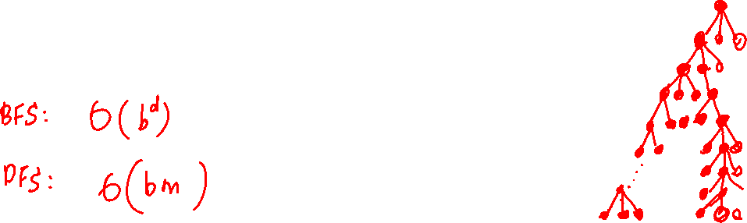
DFS vs. BFS
What’s the maximum possible size of Frontier in DFS / BFS?
$$b$$
…
$m$ layers
b: branching factor
m: maximum depth
Goals at various depths

Slide 64
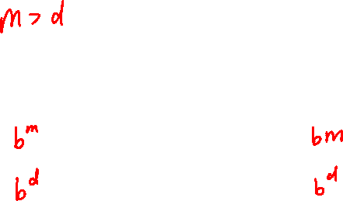
DFS vs. BFS
 | Time | Frontier Size
DFS
BFS
So DFS can be more memory-efficient than BFS?
Yes … but not with our current implementation

Slide 65



DFS
Frontier $←$ { initial_state }
While Frontier is not empty:
Pop the newest node $s$ from Frontier
For all action $a$:
$$s^{′}←succ(s,a)$$
If not Reached[$s′$]:
If $s′$ is a goal state, terminate
Push $s′$ to Frontier
Reached[$s′$] $←$ True

Slide 66


DFS
Frontier $←$ { initial_state }
While Frontier is not empty:
Pop the newest node $s$ from Frontier
For all action $a$:
$$s^{′}←succ(s,a)$$
If $s′$ is a goal state, terminate
Push $s′$ to Frontier
Because we omit the check, the algorithm may end up search in same sub-trees multiple times.
A Memory Efficient Version of DFS for Acyclic Graphs

Slide 67
Previous DFS Example
a
G
b
c
d
e
f
S
h
p
q
r
S
d
e
p
b
c
e
h
r
q
a
a
h
r
p
q
f
p
q
f
q
c
G
q
c
G
a
a

Slide 68




DFS
Frontier $←$ { initial_state }
While Frontier is not empty:
Pop the newest node $s$ from Frontier
For all action $a$:
$$s^{′}←succ(s,a)$$
If $s′$ is not an ancestor of $s$:
If $s′$ is a goal state, terminate
Push $s′$ to Frontier
A Memory Efficient Version of DFS for Cyclic Graphs

Slide 69
(Memory Efficient) DFS
a
c
e
handling cycles
S
G
b
d
f
s

Slide 70
(Memory Efficient) DFS
a
c
e
handling cycles
S
G
b
d
f
s

Slide 71
(Memory Efficient) DFS
a
c
e
handling cycles
S
G
b
d
f
s
sa

Slide 72
(Memory Efficient) DFS
a
c
e
handling cycles
S
G
b
d
f
s
sa
sab
sac

Slide 73
(Memory Efficient) DFS
a
c
e
handling cycles
S
G
b
d
f
s
sa
sab
sac

Slide 74
(Memory Efficient) DFS
a
c
e
handling cycles
S
G
b
d
f
s
sa
sab
sac
sacd
sace

Slide 75
(Memory Efficient) DFS
a
c
e
handling cycles
S
G
b
d
f
s
sa
sab
sac
sacd
sace
sacdb

Slide 76
(Memory Efficient) DFS
a
c
e
handling cycles
S
G
b
d
f
s
sa
sab
sac
sacd
sace
sacdb

Slide 77
(Memory Efficient) DFS
a
c
e
handling cycles
S
G
b
d
f
s
sa
sab
sac
sacd
sace
sacdb
sacef

Slide 78
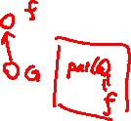
(Memory Efficient) DFS
a
c
e
handling cycles
S
G
b
d
f
s
sa
sab
sac
sacd
sace
sacdb
sacef
sacefd
sacefG

Slide 79
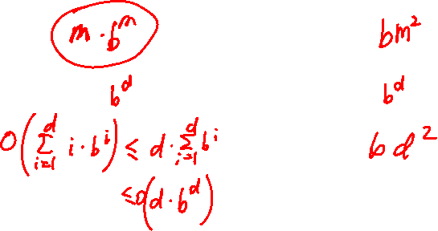

DFS vs. BFS
 | Time | Space
DFS (memory-efficient version)
BFS
IDS

Slide 80
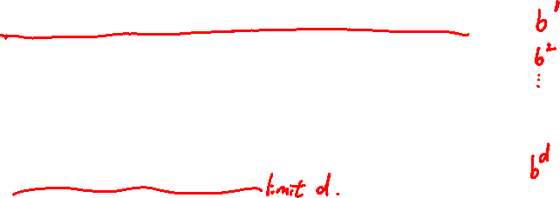
Iterative Deepening Search (IDS)
Idea: get DFS’s space advantage with BFS’s time advantage
Run a DFS with depth limit 1. If no solution…
Run a DFS with depth limit 2. If no solution…
Run a DFS with depth limit 3. …..
Isn’t that wastefully redundant?
Generally most work happens in the last level
Branching factor 10, solution 5 deep:
BFS: 10 + 100 + 1,000 + 10,000 + 100,000 = 111,110
IDS: 50 + 400 + 3,000 + 20,000 + 100,000 = 123,450

Slide 81

Which One is DFS/BFS?

Slide 82
Cost-Sensitive Search Problem
a
G
2
2
b
c
3
1
8
2
2
e
d
f
3
10
9
8
2
S
h
1
4
2
p
4
r
15
q

Slide 83
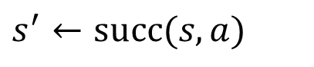









Uniform Cost Search (Dijkstra)
Frontier $←$ { initial_state }
While Frontier is not empty:
Pop a node $s$ from Frontier
Choose the one with smallest $g\left(s\right)$
If $s$ is a goal state, then terminate
For all action $a$:
$$s^{′}←succ(s,a)$$
If not Reached[$s′$]:
Put $s′$ in Frontier
Reached[$s′$] $←$ True
$$g\left(s′\right)←min \left\{ g\left(s′\right) , g\left(s\right)+cost\left(s,a\right) \right\}$$

Slide 84
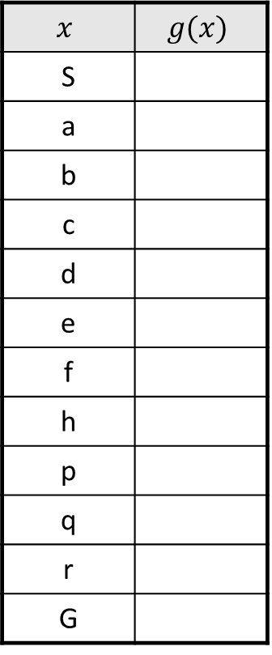
UCS
$$x$$ | $$g(x)$$
S
a
b
c
d
e
f
h
p
q
r
G
a
G
2
2
b
c
3
1
8
2
2
e
d
f
3
10
9
8
2
S
h
1
4
2
p
4
r
15
q

Slide 85
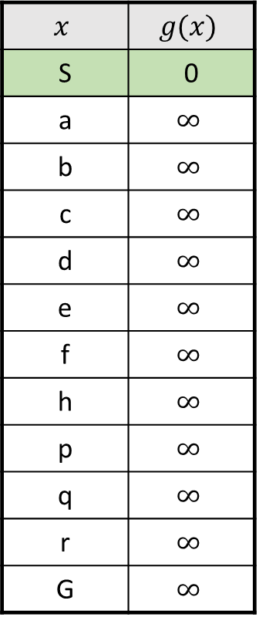
UCS
$$x$$ | $$g(x)$$
S | 0
a | $$∞$$
b | $$∞$$
c | $$∞$$
d | $$∞$$
e | $$∞$$
f | $$∞$$
h | $$∞$$
p | $$∞$$
q | $$∞$$
r | $$∞$$
G | $$∞$$
a
G
2
2
b
c
3
1
8
2
2
e
d
f
3
10
9
8
2
S
h
1
4
2
p
4
r
15
q

Slide 86
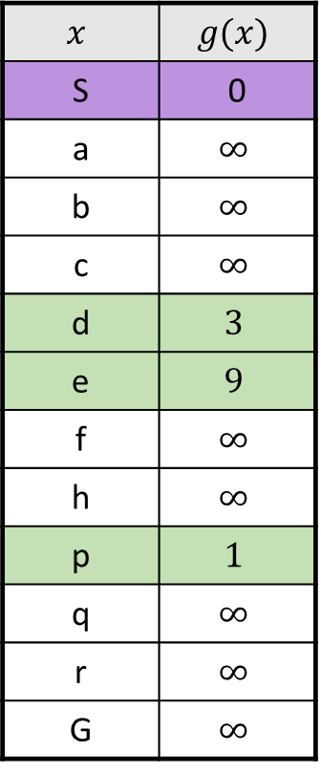
UCS
$$x$$ | $$g(x)$$
S | 0
a | $$∞$$
b | $$∞$$
c | $$∞$$
d | $$3$$
e | $$9$$
f | $$∞$$
h | $$∞$$
p | $$1$$
q | $$∞$$
r | $$∞$$
G | $$∞$$
a
G
2
2
b
c
3
1
8
2
2
e
d
f
3
10
9
8
2
S
h
1
4
2
p
4
r
15
q

Slide 87
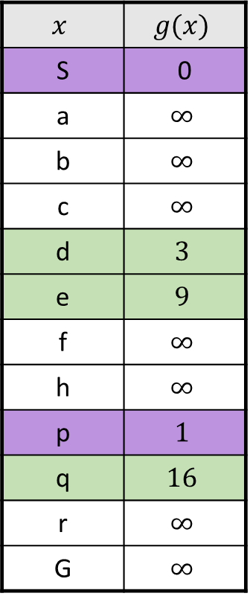
UCS
$$x$$ | $$g(x)$$
S | 0
a | $$∞$$
b | $$∞$$
c | $$∞$$
d | $$3$$
e | $$9$$
f | $$∞$$
h | $$∞$$
p | $$1$$
q | $$16$$
r | $$∞$$
G | $$∞$$
a
G
2
2
b
c
3
1
8
2
2
e
d
f
3
10
9
8
2
S
h
1
4
2
p
4
r
15
q

Slide 88
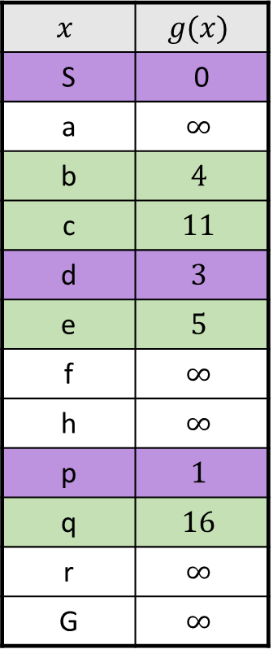
UCS
$$x$$ | $$g(x)$$
S | 0
a | $$∞$$
b | $$4$$
c | $$11$$
d | $$3$$
e | $$5$$
f | $$∞$$
h | $$∞$$
p | $$1$$
q | $$16$$
r | $$∞$$
G | $$∞$$
a
G
2
2
b
c
3
1
8
2
2
e
d
f
3
10
9
8
2
S
h
1
4
2
p
4
r
15
q

Slide 89
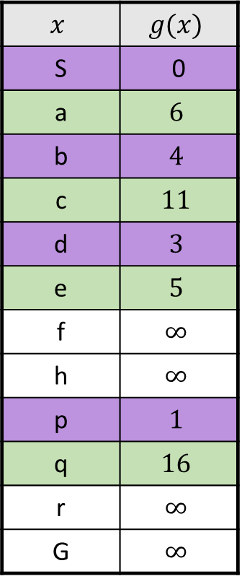
UCS
$$x$$ | $$g(x)$$
S | 0
a | $$6$$
b | $$4$$
c | $$11$$
d | $$3$$
e | $$5$$
f | $$∞$$
h | $$∞$$
p | $$1$$
q | $$16$$
r | $$∞$$
G | $$∞$$
a
G
2
2
b
c
3
1
8
2
2
e
d
f
3
10
9
8
2
S
h
1
4
2
p
4
r
15
q

Slide 90
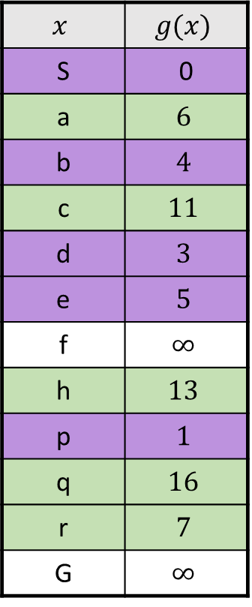
UCS
$$x$$ | $$g(x)$$
S | 0
a | $$6$$
b | $$4$$
c | $$11$$
d | $$3$$
e | $$5$$
f | $$∞$$
h | $$13$$
p | $$1$$
q | $$16$$
r | $$7$$
G | $$∞$$
a
G
2
2
b
c
3
1
8
2
2
e
d
f
3
10
9
8
2
S
h
1
4
2
p
4
r
15
q

Slide 91
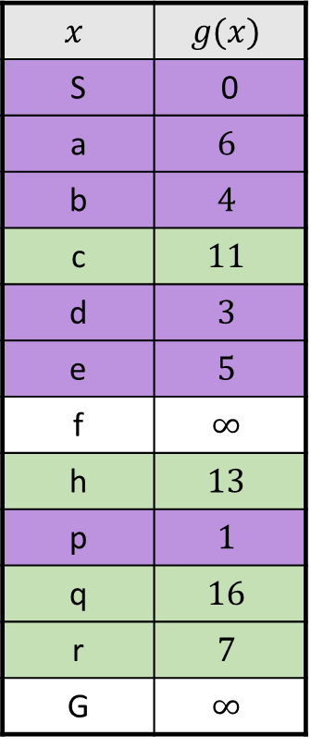
UCS
$$x$$ | $$g(x)$$
S | 0
a | $$6$$
b | $$4$$
c | $$11$$
d | $$3$$
e | $$5$$
f | $$∞$$
h | $$13$$
p | $$1$$
q | $$16$$
r | $$7$$
G | $$∞$$
a
G
2
2
b
c
3
1
8
2
2
e
d
f
3
10
9
8
2
S
h
1
4
2
p
4
r
15
q

Slide 92
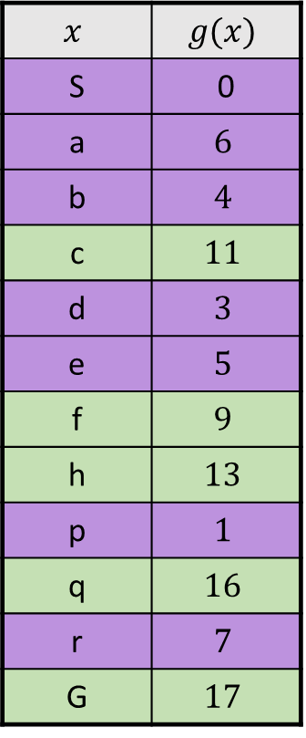
UCS
$$x$$ | $$g(x)$$
S | 0
a | $$6$$
b | $$4$$
c | $$11$$
d | $$3$$
e | $$5$$
f | $$9$$
h | $$13$$
p | $$1$$
q | $$16$$
r | $$7$$
G | $$17$$
a
G
2
2
b
c
3
1
8
2
2
e
d
f
3
10
9
8
2
S
h
1
4
2
p
4
r
15
q

Slide 93
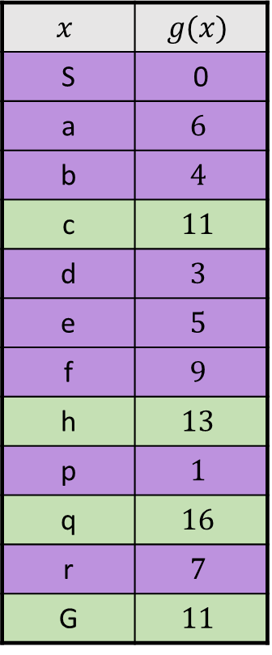
UCS
$$x$$ | $$g(x)$$
S | 0
a | $$6$$
b | $$4$$
c | $$11$$
d | $$3$$
e | $$5$$
f | $$9$$
h | $$13$$
p | $$1$$
q | $$16$$
r | $$7$$
G | $$11$$
a
G
2
2
b
c
3
1
8
2
2
e
d
f
3
10
9
8
2
S
h
1
4
2
p
4
r
15
q

Slide 94
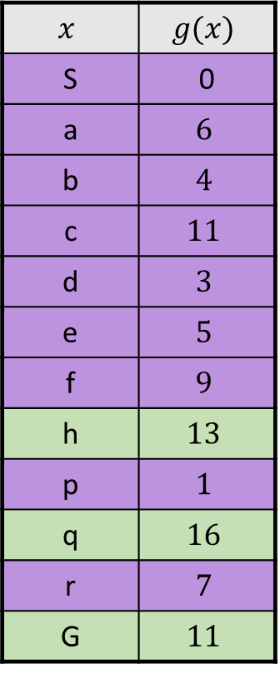
UCS
$$x$$ | $$g(x)$$
S | 0
a | $$6$$
b | $$4$$
c | $$11$$
d | $$3$$
e | $$5$$
f | $$9$$
h | $$13$$
p | $$1$$
q | $$16$$
r | $$7$$
G | $$11$$
a
G
2
2
b
c
3
1
8
2
2
e
d
f
3
10
9
8
2
S
h
1
4
2
p
4
r
15
q

Slide 95
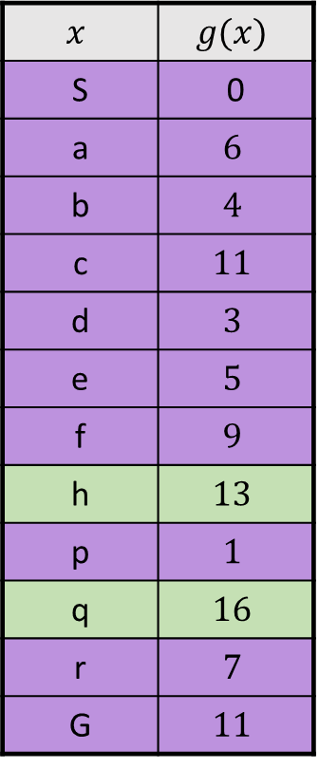
UCS
$$x$$ | $$g(x)$$
S | 0
a | $$6$$
b | $$4$$
c | $$11$$
d | $$3$$
e | $$5$$
f | $$9$$
h | $$13$$
p | $$1$$
q | $$16$$
r | $$7$$
G | $$11$$
a
G
2
2
b
c
3
1
8
2
2
e
d
f
3
10
9
8
2
S
h
1
4
2
p
4
r
15
q

Slide 96
DFS/BFS/UCS? (Deep/light blue → high/low cost)

Slide 97
DFS/BFS/UCS? (Deep/light blue → high/low cost)

Slide 98
DFS/BFS/UCS? (Deep/light blue → high/low cost)

Slide 99
Informed Search

Slide 100
Inefficiency of the Search Algorithms We See So Far

Slide 101
Inefficiency of the Search Algorithms We See So Far

Slide 102
Heuristic Function
Suppose we have some “guess” for the distance from every node to the goal.
Can we leverage it to accelerate the search?
n₁
50
6
S
G
20
n₂
8

Slide 103

Heuristic Function
Having a heuristic function that accurately predict the distance might be impossible.
However, some function that correlates with the true distance may be easy to find.
10
5
11.2

Slide 104






Greedy Best-First Search
Suppose we have a heuristic function $h\left(s\right)$.
Frontier $←$ { initial_state }
While Frontier is not empty:
Pop a node $s$ from Frontier
Choose the one with smallest $h\left(s\right)$
For all action $a$:
$$s^{′}←succ(s,a)$$
If not Reached[$s′$]:
If $s′$ is a goal state, then terminate
Push $s′$ to Frontier
Reached[$s′$] $←$ True

Slide 105
Greedy Best-First Search
b
…
If the heuristic is good
Take us directly to the goal
Like a nicely-guided DFS
In the worst case
Take us to the wrong way
Like a badly-guided DFS
b
…

Slide 106





A* Search: Combining Greedy and UCS
Suppose we have a heuristic function $h\left(s\right)$.
Backward cost
Forward cost
Frontier $←$ { initial_state }
While Frontier is not empty:
Pop a node $s$ from Frontier
Choose the one with smallest $g\left(s\right)+h\left(s\right)$
If $s$ is a goal state, then terminate
UCS is a special case with $h\left(s\right)=0$
For all action $a$:
$$s^{′}←succ(s,a)$$
If not Reached[$s′$]:
Push $s′$ to Frontier
Reached[$s′$] $←$ True
$$g\left(s′\right)←min \left\{ g\left(s′\right) , g\left(s\right)+cost\left(s,a\right) \right\}$$

Slide 107
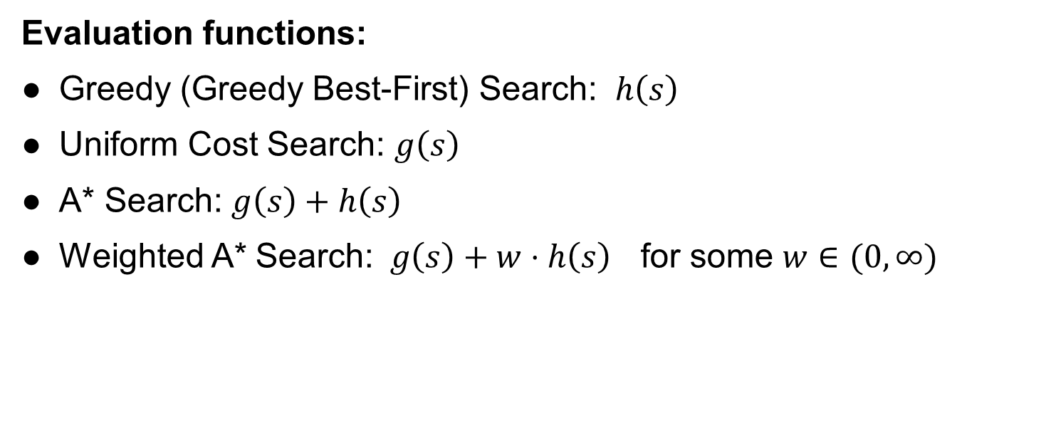
A* Search
Evaluation functions:
Greedy (Greedy Best-First) Search: $h\left(s\right)$
Uniform Cost Search: $g\left(s\right)$
A* Search: $g\left(s\right)+h\left(s\right)$
Weighted A* Search: $g\left(s\right)+w⋅h\left(s\right)$ for some $w∈(0,∞)$

Slide 108
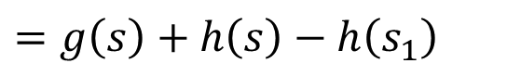
A* Search
A* Search = Uniform Cost Search with modified cost
$$\tilde{cost}\left(s,a\right)=cost\left(s,a\right)+h\left(s′\right)−h(s)$$
Proof
Let $\tilde{g}\left(s\right)$ be the values of UCS with the modified loss
$$\tilde{g}\left(s\right)=\tilde{cost}\left(s_{1}→s_{2}\right)+\tilde{cost}\left(s_{2}→s_{3}\right)+⋯+\tilde{cost}\left(s_{m}→s\right)$$
$$=\left[cost\left(s_{1}→s_{2}\right)+h\left(s_{2}\right)−h(s_{1})\right]+\left[cost\left(s_{2}→s_{3}\right)+h\left(s_{3}\right)−h(s_{2})\right] +⋯$$
$+\left[cost\left(s_{m}→s\right)+h\left(s\right)−h(s_{m})\right]$
$$=g\left(s\right)+h\left(s\right)−h\left(s_{1}\right)$$
s₂
s₃
s₁
s_{m}
s
initial state

Slide 109
UCS vs. A*
Start
Start
Goal
Goal
UCS
A*

Slide 110
UCS / Greedy Best-First / A* ?

Slide 111
UCS / Greedy Best-First / A* ?

Slide 112
UCS / Greedy Best-First / A* ?

Slide 113



Comparison
Greedy
UCS
A*

Slide 114
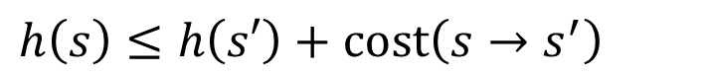
The Optimality of A*
Definitions
A heuristic function $h$ is called consistent if for all $s$ and $s′$
$$h\left(s\right)≤h\left(s′\right)+cost\left(s→s^{′}\right)$$
(triangle inequality)
and $h\left(G\right)=0$ for any goal state $G$.

Slide 115

The Optimality of A*
Theorem
If the heuristic function is consistent, then A* returns minimum-cost solution.
Proof
A* is equivalent to UCS with $\tilde{cost}\left(s→s′\right):=cost\left(s→s′\right)+h\left(s′\right)−h(s)$
Total modified cost of any path $s_{1}→s_{2}→⋯→s_{m}→G$ is
$$\tilde{cost}\left(s_{1}→s_{2}\right)+\tilde{cost}\left(s_{2}→s_{3}\right)+⋯+\tilde{cost}\left(s_{m}→G\right)$$
$$=\left[cost\left(s_{1}→s_{2}\right)+h\left(s_{2}\right)−h(s_{1})\right]+\left[cost\left(s_{2}→s_{3}\right)+h\left(s_{3}\right)−h(s_{2})\right]+⋯$$
$+\left[cost\left(s_{m}→G\right)+h\left(G\right)−h(s_{m})\right]$
$$=cost\left(s_{1}→s_{2}\right)+cost\left(s_{2}→s_{3}\right)+⋯+cost\left(s_{m}→G\right)−h(s_{1})$$
Since $\tilde{cost}\left(s→s′\right)≥0$ by the consistency of $h$, A*’s optimality follows UCS’s optimality under non-negative cost.

Slide 116
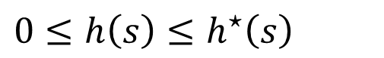
The Optimality of A*
Definitions
A heuristic function $h$ is called admissible if for all $s$
$$0≤h\left(s\right)≤h^{⋆}\left(s\right)$$
where $h^{⋆}\left(s\right)$ is the true minimum distance from $s$ to goal.
Theorems
If $h$ is consistent, then it is also admissible.
If the heuristic function is admissible and the graph is a tree, then A* returns minimum-cost solution.

Slide 117
The Optimality of A*
For general graphs, we can treat it like a tree by omitting the condition “if not Reached[s’]” in the graph search algorithm (like what we did for memory-efficient DFS).
This allows us to apply the theorem in the previous page.
S
a
G
d
e
p
b
c
b
c
e
h
r
q
d
e
f
S
h
a
a
h
r
p
q
f
p
q
r
p
q
f
q
c
G
q
c
G
a
a

Slide 118
Admissible but not Consistent
A
1
S
1
C
h=4
h=1
h=2
1
2
B
3
h=1
G
h=0

Slide 119
Admissible but not Consistent
S (0+2)
A
1
S
1
C
h=4
h=1
h=2
1
2
B
3
h=1
G
Expanded = { }
h=0

Slide 120
Admissible but not Consistent
S (0+2)
A
1
A (1+4)
B (1+1)
S
1
C
h=4
h=1
h=2
1
2
B
3
h=1
G
Expanded = { S }
h=0

Slide 121
Admissible but not Consistent
S (0+2)
A
1
A (1+4)
B (1+1)
S
1
C
h=4
h=1
h=2
1
C (3+1)
2
B
3
h=1
G
Expanded = { S, B }
h=0

Slide 122
Admissible but not Consistent
S (0+2)
A
1
A (1+4)
B (1+1)
S
1
C
h=4
h=1
h=2
1
C (3+1)
2
B
3
G (6+0)
h=1
G
Expanded = { S, B, C }
h=0

Slide 123
Admissible but not Consistent
S (0+2)
A
1
A (1+4)
B (1+1)
S
1
C
h=4
h=1
h=2
1
C (2+1)
C (3+1)
2
B
3
G (6+0)
h=1
G
Expanded = { S, B, C }
h=0

Slide 124
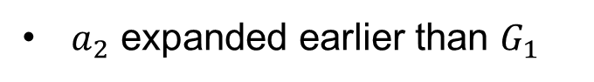




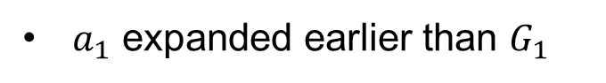
The Optimality of A*
Assume
$$dist\left(s,G_{2}\right)<dist\left(s,G_{1}\right)$$
By the tree structure, every node can only be reached by its unique predecessor
If admissible + tree, then A* returns minimum-cost solution.
$n$ expanded earlier than $G_{1}$
Proof by contradiction
$a_{1}$ expanded earlier than $G_{1}$
$$∵f\left(a_{1}\right)=g\left(a_{1}\right)+h\left(a_{1}\right)≤g\left(a_{1}\right)+h^{⋆}\left(a_{1}\right)$$
Path returned by A*
Optimal Path
$$=dist\left(s,G_{2}\right)<dist\left(s,G_{1}\right)≤g\left(G_{1}\right)=f(G_{1})$$
$a_{2}$ expanded earlier than $G_{1}$
n
$$∵f\left(a_{2}\right)=g\left(a_{2}\right)+h\left(a_{2}\right)≤g\left(a_{2}\right)+h^{⋆}\left(a_{2}\right)$$
s
$$=dist\left(s,G_{2}\right)<f(G_{1})$$
a₁
G₁
$$…$$
a₂
$a_{m−1}$ expanded earlier than $G_{1}$
a_{m-1}
G₂
$G_{2}$ expanded earlier than $G_{1}$

Slide 125
Creating Admissible/Consistent Heuristics
Most of the work in solving hard search problems is in coming up with admissible/consistent heuristics.
Often, admissible/consistent heuristics are solutions to relaxed problems, where new actions are available.
Inadmissible heuristics are often useful too.
366
15

Slide 126
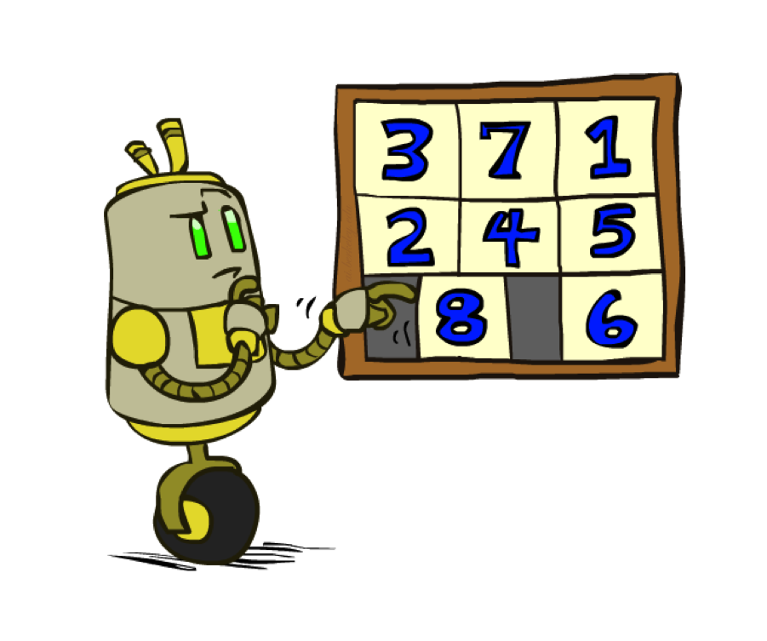
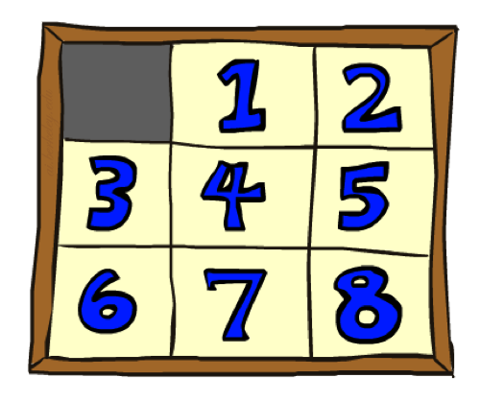
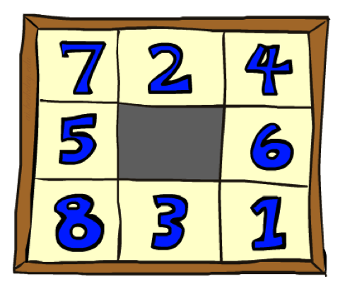
Example: 8 Puzzles
Goal State
Start State
 | Average nodes expanded when the optimal path has…
 | …4 steps | …8 steps | …12 steps
UCS | 112 | 6,300 | 3.6 x 10⁶
#wrong tile | 13 | 39 | 227
Manhattan | 12 | 25 | 73

Slide 127
Homework 1
Xuhui Kang, Haolin Liu
Deadline: 11:59PM, September 16

Slide 128
Homework 1
1. Choice Questions (10 points)
a. 14 questions.
b. Choice questions are 10 points in total and distributed evenly
2. Program Questions (25 points)

Slide 129
Homework 1: Choice Questions
Each question may be either single-choice or multiple-choice. Read carefully and select your answers accordingly.
Grading:
Full Credit: If all correct options are selected.
Partial Credit: If only some correct options are selected, with no wrong options chosen.
No Credit: If any incorrect options are selected.
Submission: Please answer directly on Gradescope. No need to submit a separate PDF.
Scores and correct answers will not be released immediately after submission.

Slide 130
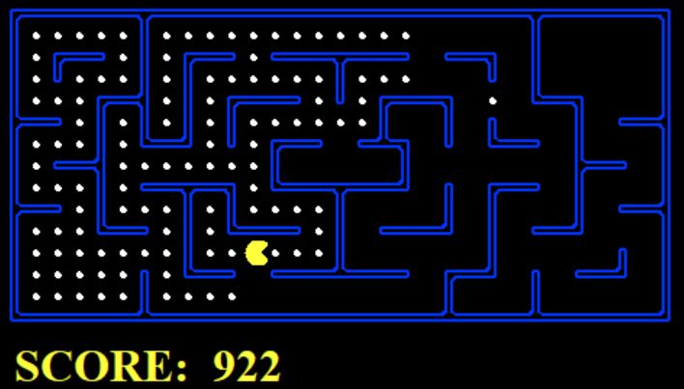
Homework 1: Coding
In this problem, you are going to help Pacman find paths in a maze world by focusing on implementing search algorithms.
Autograder is given both offline and online in GradeScope. Your grade in gradescope is the final grade.

Slide 131
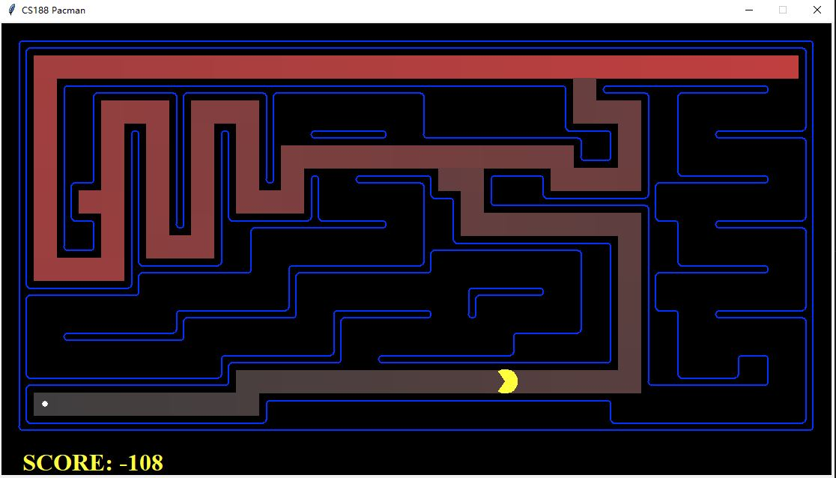
Homework 1: Coding
Question 1 -- 4: Implement Depth First Search, Breadth First Search, Uniform Cost Search, and A* algorithm. Your goal is to reach a target area.

Slide 132
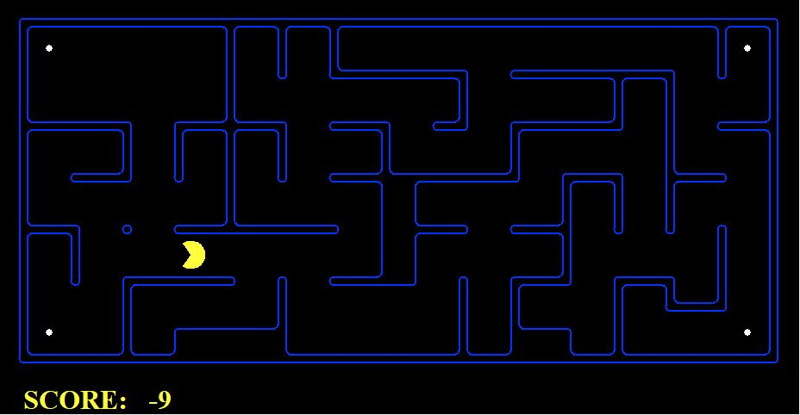
Homework 1: Coding
Question 5 : The goal of this question is to visit all four corners rather than reaching a destination state.
Question 6: In the corner search problem, you need to implement an admissible heuristic function for A* algorithm.
You may need to consider more complex state space, which not only contain possible coordinate of the Pac-Man, but tracking the visitation of corners as well.

Slide 133
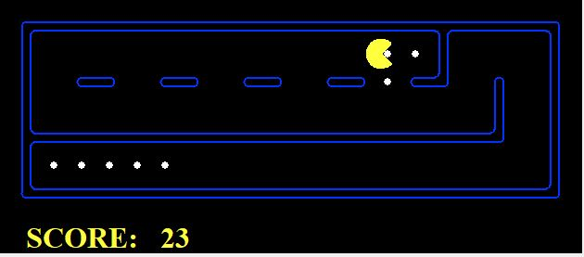
Homework 1: Coding
Question 7 : The goal of this question is to find a way to eat all of the pellets in the maze. The position of the pellets is known to the pacman.

Slide 134
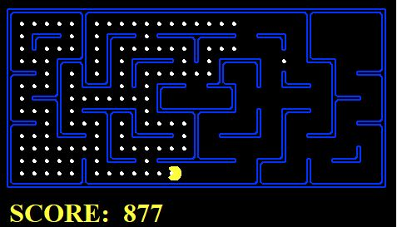
Homework 1: Coding
Question 8 : The goal of this question is to eat the closest dot (pellet) by finding the path to it.

